Slide 1
Performance analysis of Apriori Algorithm using MongoDB
GROUP-7
Avishek Mitra s-430
Somnath Palodhi s-424
Sulagna Chakraborty s-436

Slide 2

Domain Description
Nowadays we need to work with a huge amount of data in some companies the average amount of records are 3-4 billion per day. In this situation work with SQL server backend that collects and stores an extremely large amount of records. It can crash because it is very time-consuming to get table records.
To overcome this problem NoSQL database comes into the field. Dozens of NoSQL data stores are available MongoDB is one of them. It is an open-source document database. It usually does not have a schema. It has more few features like Document-oriented means instead of having data in relational type format, it stores the data in the document. This makes MongoDB very flexible and adaptable to real business world situations and requirements.
We want to implement the Apriori algorithm using MongoDB as a database. At first, we implement the algorithm with flat files and RDBMS.Also, we calculate the program runtime in each case and we want to a performance comparison between them.

Slide 3

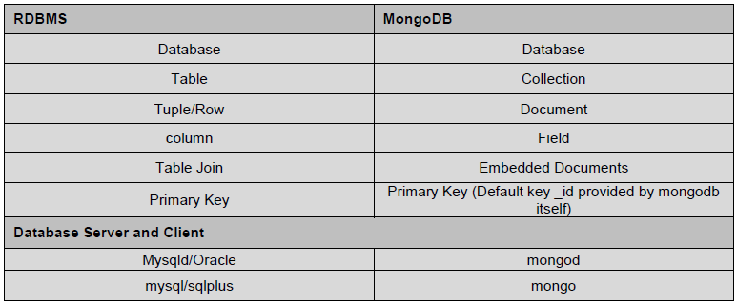
INTRODUCTION OF MONGODB
MongoDB is a cross-platform, document oriented database that provides, high performance, high availability and easy scalability. MongoDB works on concept of collection and document.
Below given table shows the relationship of RDBMS terminology with MongoDB

Slide 4
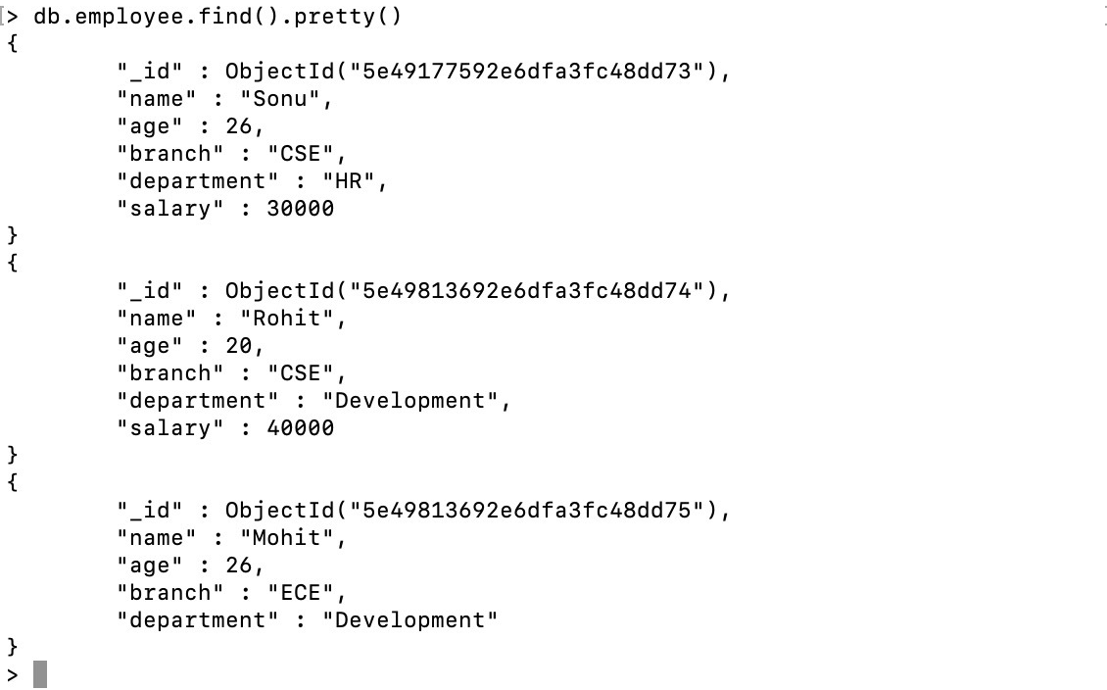
Sample document

Slide 5

Advantages of MongoDB over RDBMS
Schema less : MongoDB is document database in which one collection holds different documents. Number of fields, content and size of the document can be differ from one document to another.
1
2
Structure of a single object is clear
No complex joins
3
Deep query-ability. MongoDB supports dynamic queries on documents using a document-based query language that's nearly as powerful as SQL

Slide 6

Defination of Apriori Algorithm
The Apriori algorithm uses frequent item sets to generate association rules, and it is designed to work on the databases that contain transactions.
Apriori algorithm is used for discovering interesting patterns and mutual relationships and hence is treated as an unsupervised learning approach. Thought the algorithm is highly efficient, it consumes a lot of memory, utilizes a lot of disk space and takes a lot of time.
This algorithm uses a breadth-first search and Hash Tree to calculate the itemset associations efficiently. It is the iterative process for finding the frequent itemset from the large dataset.

Slide 7
Motivation and Scope of the work
Motivation : In generally an Apriori Algorithm is implementing by using flat files as database and it is very time consuming. Also handle a huge amount of data is very difficult. So we want to a experiment with NoSQL database and we want to implement this Data Mining algorithm with MongoDB . We think that it will be more effective than others and we also use MySQL to give a comparison with MongoDB.
Scope of the work
Through our project we done maximum software related work like searching of useful data within minimum time. Though it is reducing the time so it can increase sales and customer satisfaction in future.
Our project is efficient for market basket analysis and helps to enhance market sale by assisting customers during the purchase of the item. Another popular application is Google Autocomplete in which the search engine suggests the other associated words according to your specified word, and also it is used in the Amazon recommendation system.
In this project we use MongoDB in Bigdata environment, and it will save our time in future works.

Slide 8
Background/Review of Related Work
In the last few years, the researchers have shown the impact of MongoDB on the real life events and needs in their research activities. Moreover, a notable amount of works have been proposed in the related fields to monitor the effect of the same. We also learn about MongoDB from web sites like Tutorialspoint, GeeksforGeeks etc.
We have reviewed some of the articles and works as per our Project interest:
1.C. Győrödi, R. Győrödi, G. Pecherle and A. Olah, “A comparative study: MongoDB vs. MySQL.,” 13th International Conference on Engineering of Modern Electric Systems (EMES), pp. 1-6, 2015.
2. Z. Wei-Ping, L. Ming-Xin and C. Huan, "Using MongoDB to implement textbook management system instead of MySQL," IEEE 3rd International Conference on Communication Software and Networks, pp. 303-305, May 2011
3. M. Al-Maolegi and B. Arkok, An improved Apriori algorithm for association rules., arXiv preprint arXiv:1403.3948., 2014
Etc.
After review these projects and papers, we understood that Performance analysis of Apriori Algorithm using Excel file, RDBMS(MySQL) and NoSQL(MongoDB) had not already performed together.

Slide 9
Methodology
PROBLEM FORMULATION : On a day-to-day work with data mining or machine learning algorithms is very time-consuming and present days we have to work with flat files and RDBMS. It is very difficult to work with and management on Bigdata environment is getting complex.
Algorithm Description:
Apriori algorithm is used for discovering interesting patterns and mutual relationships and hence is treated as an unsupervised learning approach. Thought the algorithm is highly efficient, it consumes a lot of memory, utilizes a lot of disk space and takes a lot of time.
Application
In Education Field: Extracting association rules in data mining of admitted students through
characteristics and specialties.
In the Medical field: For example Analysis of the patient's database.
In Forestry: Analysis of probability and intensity of forest fire with the forest fire data.

Slide 10
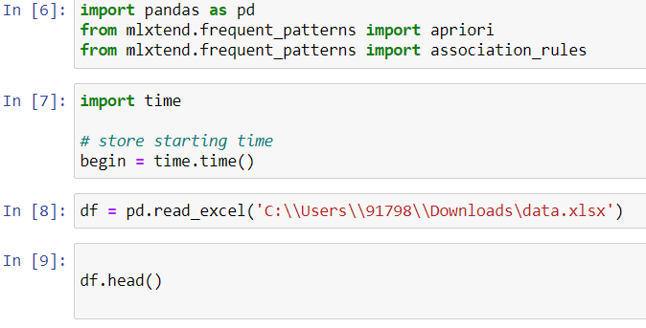
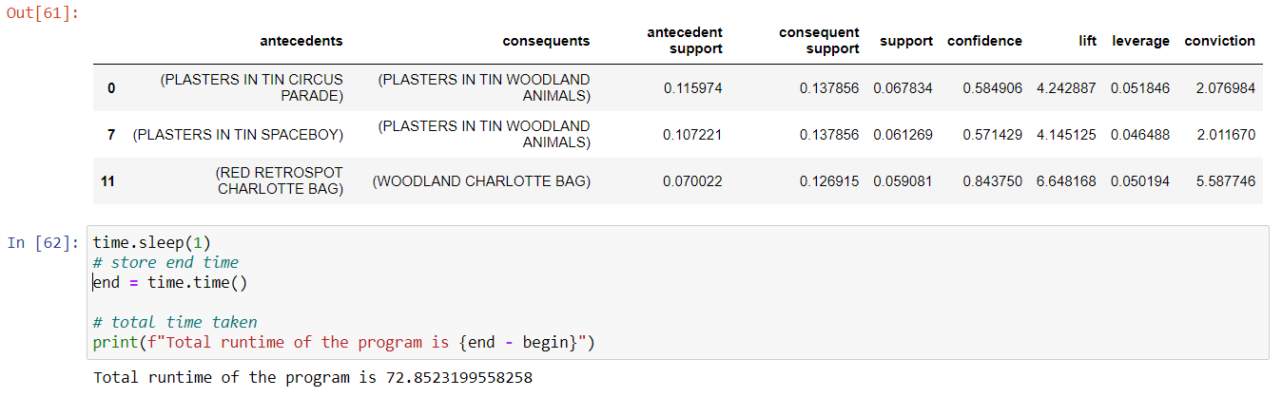
Implementation (Implementing Apriori algorithm using Excel file)
1.Organized all the data in an Excel file.
2.At first add some libraries like Mlxtend, Pandas for the day-to-day task.
3.Then add the Excel file to the python by using [ pd.read_excel()]. We have to give the path of the excel file. (Figure 1)
4.Write down the source code of the Apriori algorithm.
5.At the end calculate the time taken by this program. (Figure 2)
figure 1 figure 2

Slide 11
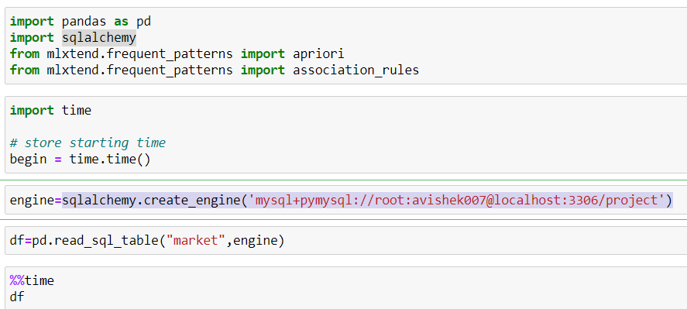
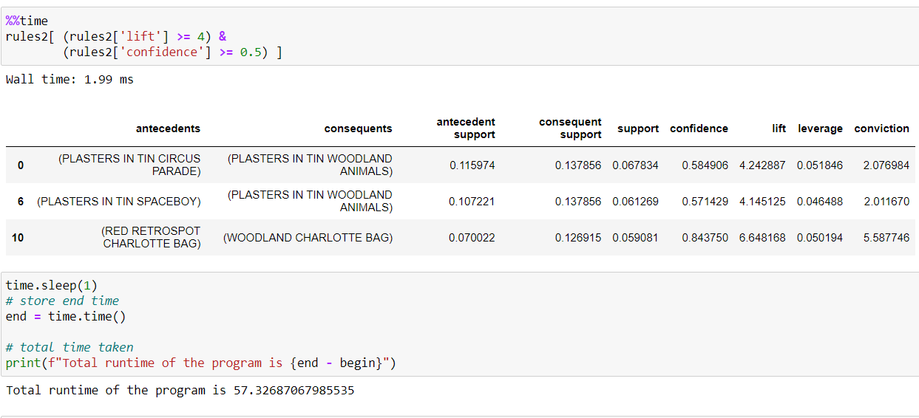
Implementing Apriori algorithm using MySQL
1.At first, we have to make a local host, a database, and a table for storing data.
2.Then Import the data into MySQL’s table.
3.Add some libraries like Mlxtend, sqlalchemy, etc at the beginning.
4.Now connect MySQL with Python by using[sqlalchemy.create_engine()] and added localhost, root, database name, and table name. (Figure 3)
5.Write down the source code of the Apriori algorithm.
6.At the end calculate the time taken by this program. (Figure 4)
figure 3 figure 4

Slide 12
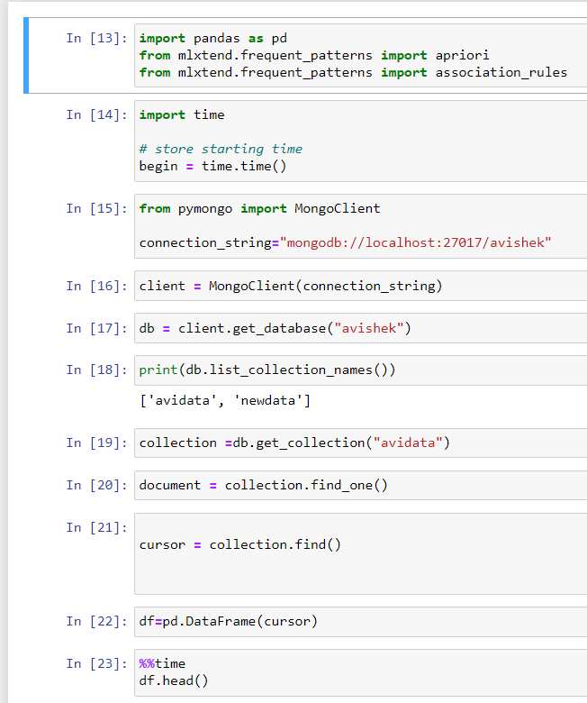
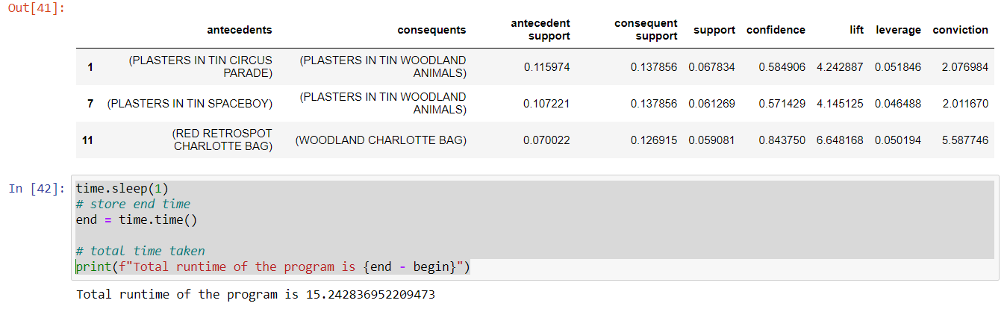
Implementing Apriori algorithm using MongoDB
1.At first, we have to make a localhost, database, and a collection for storing data.
2.Then Import the data into MongoDB’s collection.
•Open the Import Wizard. Then, choose CSV as the import format.
• Click on the folder icon and locate the CSV file to be imported.
•Then Run this task and your data is successfully imported.
3. Add some libraries like Mlxtend, Pandas for day-to-day tasks.
4. Next connect MongoDB with python. (Figure 6)
•We have to connect with MongoDB to Python by adding the path("mongodb://localhost:27017/avishek").
•Then add the database name, collection name where the data is store in MongoDB.
•Store the data into an object.
5. Write down the source code of the Apriori algorithm.
6. At the end calculate the time taken by this program (figure7)
figure 6
figure 7

Slide 13
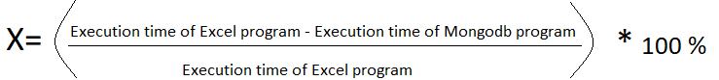
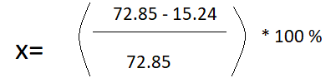
Result
After implementation, we calculated the time taken for every execution.
The Apriori algorithm program, which connects with the Excel file takes time for total execution is 72.85 sec.
The Apriori algorithm program, which connects with the MySQL takes time for total execution is 57.32 sec.
The Apriori algorithm program, which connects with MongoDB takes time for total execution is 15.24 sec.
X= 79 %
After calculation, we found that MongoDB is 79% faster than excel files in the Apriori algorithm.
Now we calculate the percentage of how much timeMongoDB is faster than excel file.
X = percentage

Slide 14
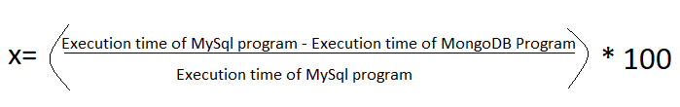
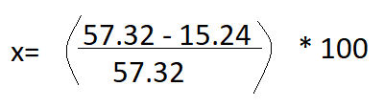
Result
Now we calculate the percentage of how much time MongoDB is faster than MySQL
X= 73%
After calculation, we found that MongoDB is 73% faster than MySQL in the Apriori algorithm.

Slide 15
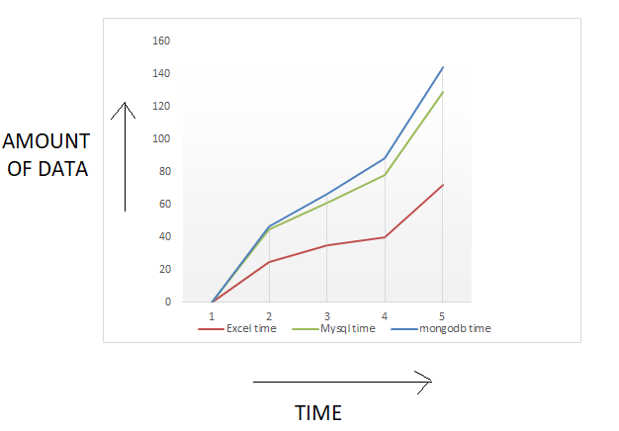
Discussion
After getting the result we found that MongoDB is more efficient when we work Bigdata. Below the image(figure 7)we can see that when the number of data is increasing MySQL and Excel files getting slow as respect to MongoDB.
In our project “Performance analysis of Apriori algorithm using MongoDB” is proof that MongoDB is faster instead of using MySQL and Excel files in Big data environment.
figure 7

